Slide 1
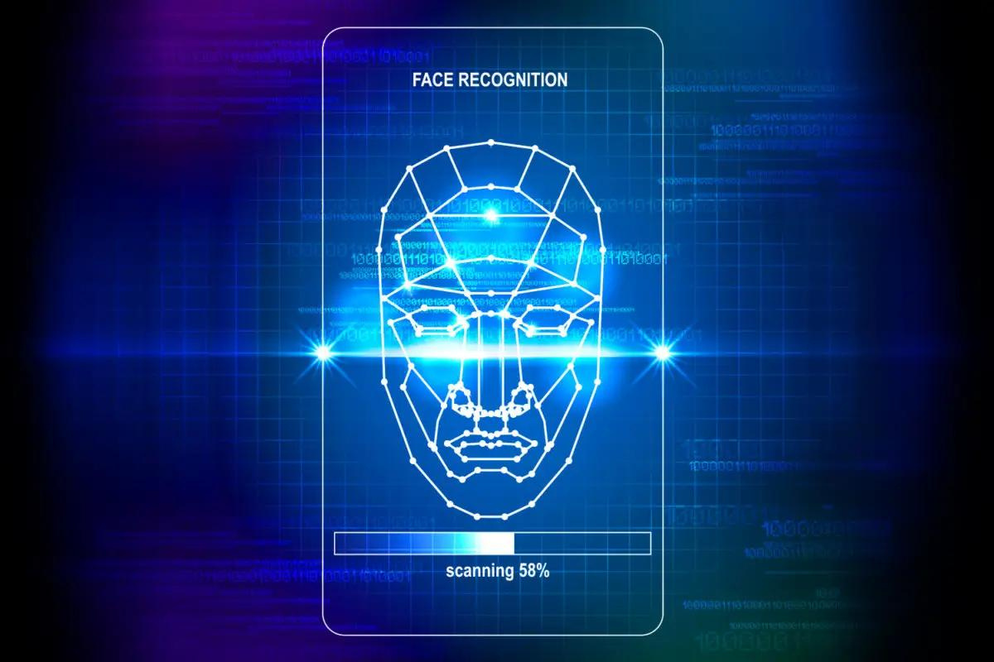



COMPUTER
ARCHITECTURE LAB PROJECT
Name - Kaushal Raj
Roll no. - 2001CSS36

Slide 2

Face Recognition Based Attendance System using ESP32 CAM
Project Overview:
In this project, I had made a Face Recognition Based Attendance system using ESP32 CAM module and Python.

Slide 3

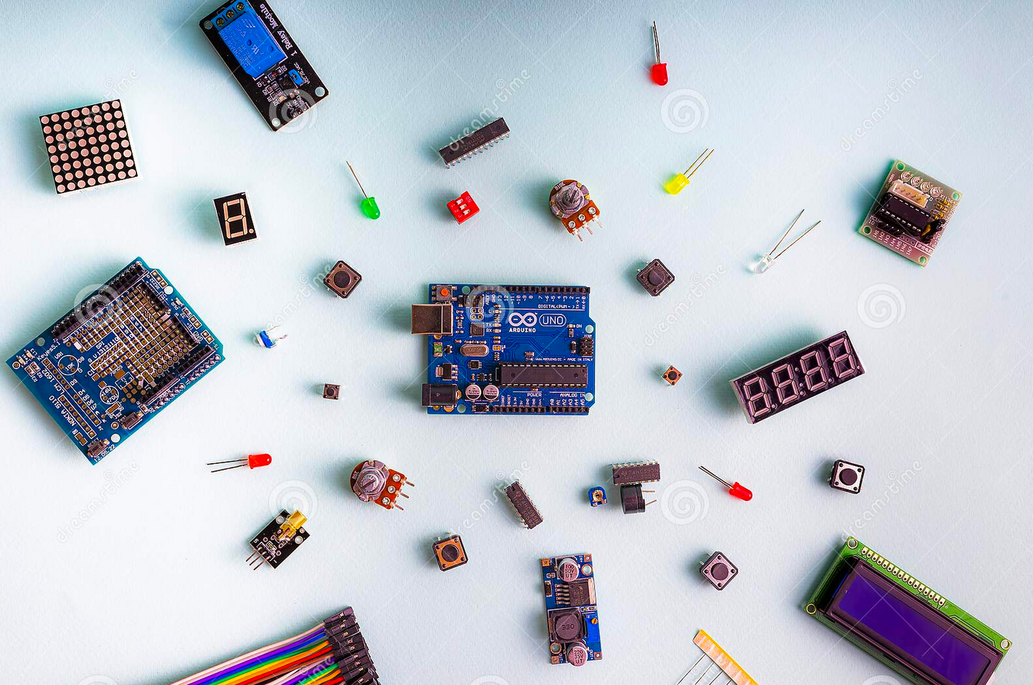

The Components Used
ESP32-CAM Module
ESP32-CAM-MB MICRO USB Module
USB CABLE
JUMPER WIRES

Slide 4

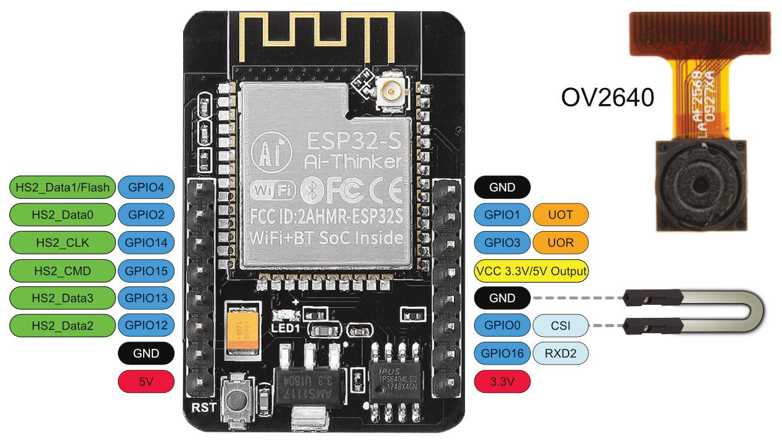
ESP32-CAM
The ESP32-CAM is a development board that has a WIFI+ Bluetooth development board based on the ESP32 chip with the additional option of using a camera.
It is ideal for various IoT applications. with the OV2640 camera, microSD card slot, and several GPIOs to connect peripherals onboard you can create unlimited ideas and IoT Projects, such as home intelligent devices, industrial wireless control, wireless monitoring, QR wireless identification, wireless positioning system signals, and other Internet of Things applications.
Pinout of the Module

Slide 5
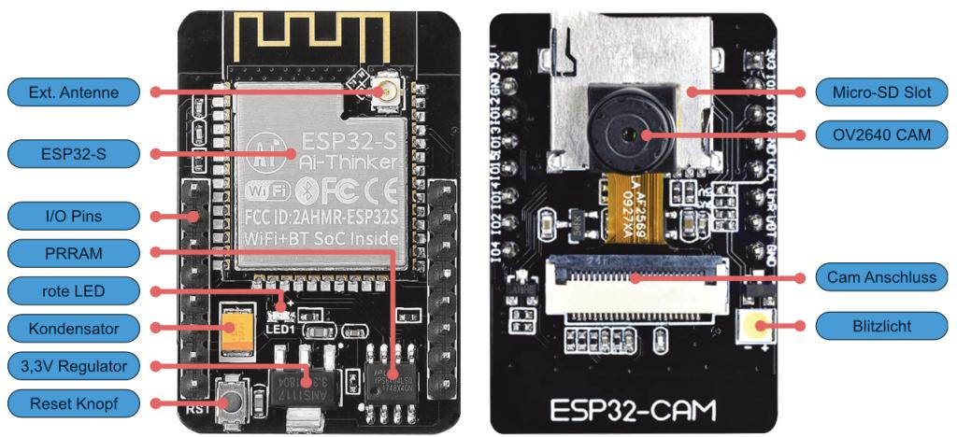
Components Details
Camera Specifications
The ESP32-CAM includes an OV2640 camera module. The device also supports OV7670 cameras. The OV2640 has the following specifications:
2 Megapixel sensor
Array size UXGA 1622×1200
Output formats include YUV422, YUV420, RGB565, RGB555 and 8-bit compressed data
Image transfer rate of 15 to 60 fps
Hardware Included on the Board

Slide 6
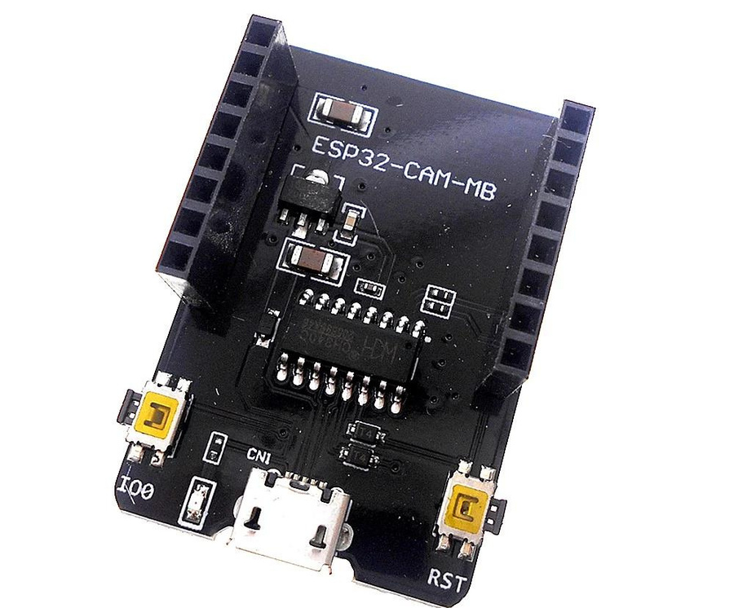
Components Details
ESP32-CAM-MB camera module
The ESP32-CAM AI-Thinker MB programmer is a shield that you attach to your ESP32-CAM board GPIOs. The following image shows the programmer and the ESP32-CAM side by side.
The programmer comes with the CH340C USB to serial chip.
This allows you to program the ESP32-CAM using the USB port on the shield.
Additionally, the shield also comes with a RESET and a BOOT (IO0) buttons. This may be useful to easily reset the ESP32-CAM or put it into flashing mode.

Slide 7

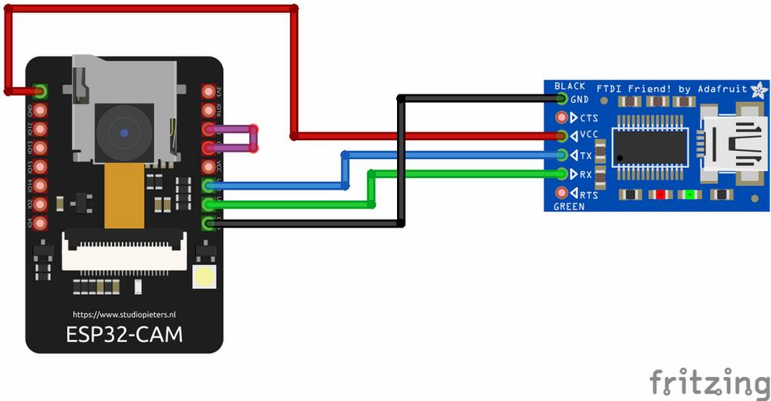
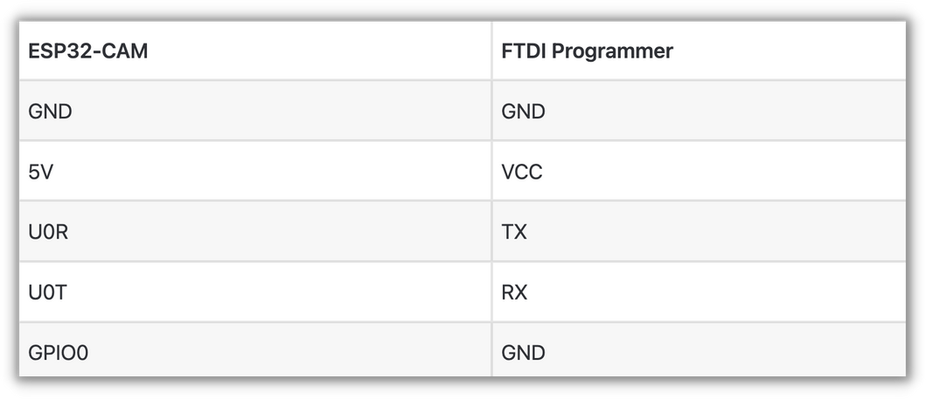
Circuit Design
Connection between FTDI Module and ESP32 CAM module

Slide 8


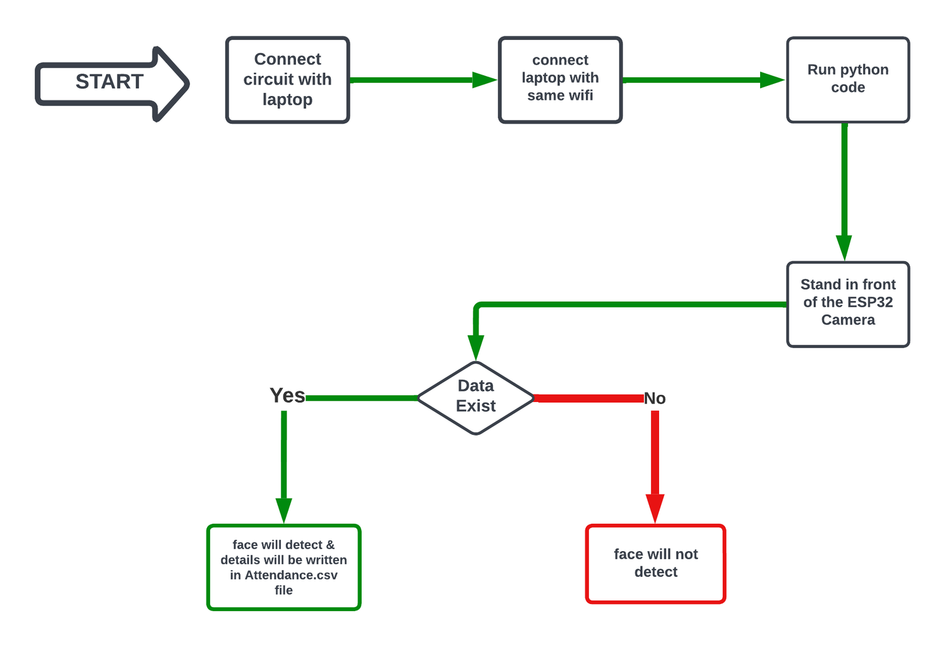
Flow Chart

Slide 9


Working:
In this attendance system, we will not just detect the person but also store the information of the person detected in a Microsoft Excel File.
Moreover, the duration of time they have stayed in the frame is also recorded into an excel sheet.

Slide 10


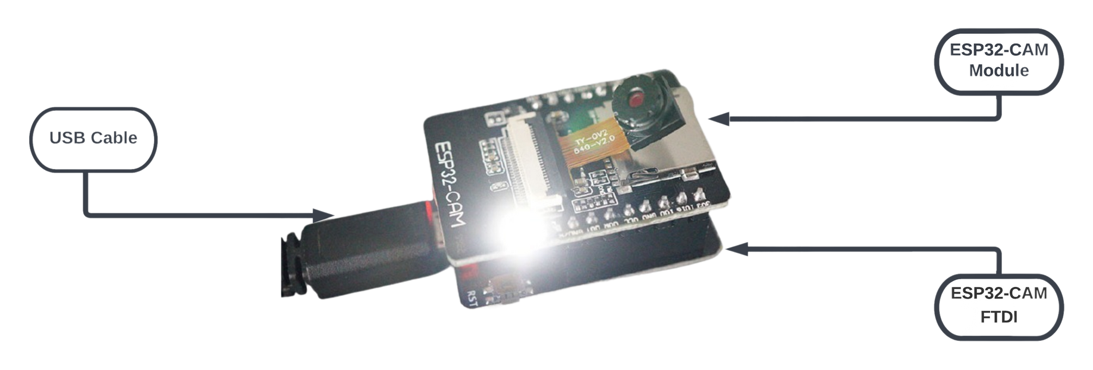
Circuit:

Slide 11

THANK YOU!

